Slide 1

DAYANANDA SAGAR UNIVERSITY
SCHOOL OF ENGINEERING
Department of Computer Science and Technology
Major Project Phase-II
AI/ML BASED HARDWARE SECURITY FOR EDGE DEVICES IN IOT
Under the Supervision
Prof. VISHWAS D B
Presented By:
Sourabh J Gor (ENG21CS0411)
Sri Vishnavi Ananya Gollapalli(ENG21CS0414)
N Rishi Rohan(ENG21CS0256)
Tejas B(ENG21CS0446)
Notes:
Title of the project
CSE Dept., SET-Jain University

Slide 2
Overview
Abstract
Problem Statement
Introduction
Social/Environmental Impact
State of the Art work
Design
Methodology
Implememtation
Results if any
References
Dept of CSE., SOE-Dayananda Sagar University
<number> of 12

Slide 3
Abstract
Why this work?
Traditional encryption methods are vulnerable to key theft and duplication.
Need for a hardware-based, unique key for secure IoT communication.
Enhancing security using AI/ML-driven chaotic encryption.
What do we plan to do?
Generate a unique PUF (Physically Unclonable Function) key from SRAM variations.
Use chaotic encryption (logistic map) for randomness in encryption.
Securely transmit encrypted sensor data to the server.
Dept of CSE., SOE-Dayananda Sagar University
<number> of 12
Notes:
Title of the project
CSE Dept., SET-Jain University

Slide 4
Abstract
How will we do it? (Approach)
Extract an 8-bit unique key from SRAM noise.
Encrypt sensor data using chaotic encryption and XOR with the PUF key.
Convert encrypted data to Base64 for safe transmission.
Implement Flask server for key registration and data reception.
Expected Results
Device-Specific Security – Unique keys for every device.
Unpredictable Encryption – Chaotic maps ensure randomness.
Secure Data Transmission – Prevents key duplication or data tampering.
Lightweight Implementation – Ideal for IoT edge devices.
Dept of CSE., SOE-Dayananda Sagar University
<number> of 12

Slide 5
Problem Statement
Problem:
Traditional encryption methods rely on pre-stored keys, which are vulnerable to theft, duplication, and unauthorized access, making IoT edge devices susceptible to security breaches.
Solution:
Implement PUF-based key generation and chaotic encryption to provide a unique, hardware-derived security mechanism, ensuring unpredictable, device-specific encryption for IoT data transmission.
Dept of CSE., SOE-Dayananda Sagar University
<number> of 12

Slide 6
Introduction
Current Status: Implemented PUF key extraction, chaotic encryption, data transmission, and server encryption.
What We Plan to Do: Add an ML model to monitor device health and trigger PUF key re-registration if degradation is detected; enhance PUF key transmission using hash verification and a challenge-response mechanism.
Scope of the Project: Ensure secure, device-specific encryption, lightweight IoT security, real-time device health monitoring, and tamper-proof key management.
Assumptions: SRAM variations are unique for each device, network stability allows reliable transmission, and server validation prevents unauthorized access.
Dept of CSE., SOE-Dayananda Sagar University
<number> of 12

Slide 7
Social/Environmental Impact
Enhances IoT security in critical applications like healthcare, smart grids, and industrial automation, preventing data breaches and unauthorized access. Reduces electronic waste by enabling secure key regeneration instead of replacing compromised devices.
Dept of CSE., SOE-Dayananda Sagar University
<number> of 12

Slide 8
State of the Art-work : Literature Survey 1
Author’s Name/ Paper Title | Conference/Journal Name and year | Technology/ Design | Results shared by author | What you infer
Authors: 1.Manishankar S 2. Dechamma TS 3. Anoop A Paper title: Securing IoT Data in the Cloud with Blockchain Technology | Conference: Asian Conference on Innovation in Technology (ASIANCON) Year: 2021 | The SHA-512 hashing algorithm is utilized for enhanced data security along with blockchain technology, improving the system’s resilience to brute-force attacks. | Demonstrated reduced tampering risk for IoT data stored in the cloud. Transaction processing times were analyzed, showing an average transaction time of 0.04 seconds, indicating high efficiency for real-time applications. | Blockchain technology combined with SHA-512 provides an effective approach for secure IoT data management in cloud environments. The paper does not provide sufficient evidence on the resource demands of the blockchain implementation, which are crucial for evaluating its practical deployment in constrained IoT environments.
Dept of CSE., SOE-Dayananda Sagar University
<number> of 12

Slide 9
State of the Art-work : Literature Survey 2
Author’s Name/ Paper Title | Conference/Journal Name and year | Technology/ Design | Results shared by author | What you infer
Authors: 1. Ms. Swati Kulkarni 2. Dr. Vani R.M. 3. Dr. P.V. Hunagund Title: "FPGA-based Hardware Security for Edge Devices in Internet of Things" | Conference: Fifth International Conference on Communication and Electronics Systems (ICCES 2020) Year: 2020 | The paper uses Physically Unclonable Functions (PUF) to enhance hardware security. Implements two types: Ring Oscillator (RO-PUF) and Arbiter PUF on FPGA. | The RO-PUF and Arbiter PUF successfully generated unique, random keys for each device, enhancing security. It demonstrated effective resource utilization and reliability under consistent environmental conditions (temperature, voltage). | The paper provides a baseline security solution for IoT devices, using PUFs for unique identification and key generation to prevent device cloning. SRAM PUF is found to be the easiest to implement without any additional hardware and is the most light weight
Dept of CSE., SOE-Dayananda Sagar University
<number> of 12

Slide 10
State of the Art-work : Literature Survey 3
Author’s Name/ Paper Title | Conference/Journal Name and year | Technology/ Design | Results shared by author | What you infer
Authors: 1. Naqash Azeem Khan 2. Azlan Awang 3. Samsul Ariffin Abdul Karim Title: "Security in Internet of Things: A Review" | Journal: IEEE Access Year: 2022 | The paper surveys various IoT security frameworks, covering machine learning, blockchain, fog computing, and edge computing as potential solutions. It categorizes IoT security threats across different layers and reviews existing technologies for mitigating these vulnerabilities. | The authors provide a comprehensive study of security threats and potential mitigation techniques within IoT. They identify promising areas for future research, noting that machine learning and blockchain show significant potential for improving IoT security. | Multiple security solutions across network layers, highlighting areas such as machine learning for anomaly detection and blockchain for data integrity. Although thorough, the paper remains a high-level survey without implementation of the proposed solutions. This limits its utility in practical IoT environments.
Dept of CSE., SOE-Dayananda Sagar University
<number> of 12

Slide 11
State of the Art-work : Literature Survey 5
Author’s Name/ Paper Title | Conference/Journal Name and year | Technology/ Design | Results shared by author | What you infer
Authors: 1. Ali Ghaffari, Nasim Jelodari Samir. 2.Pouralish 3.Nahide Derakhshanfard4.Bahman Arasteh Title: "Securing Internet of Things using Machine and Deep Learning Methods: A Survey" | Journal: Cluster Computing Year: 2024 | The paper surveys various Machine Learning (ML) and Deep Learning (DL) methods applied to IoT security. It presents a taxonomy of cyber threats in IoT systems and categorizes ML/DL approaches used to tackle these security challenges. | The paper highlights the strengths of specific ML/DL techniques, such as SVM and CNN, in achieving high accuracy for IoT security tasks. It provides a comprehensive comparison of methods, discussing the advantages and limitations of each ML/DL model for IoT security applications. | 1. While informative, the paper lacks an implementation or case studies validating the effectiveness of these ML/DL models in real-world IoT scenarios.
Dept of CSE., SOE-Dayananda Sagar University
<number> of 12

Slide 12
State of the Art-work : Literature Survey 6
Author’s Name/ Paper Title | Conference/Journal Name and year | Technology/ Design | Results shared by author | What you infer
Authors: 1. Salman Ali 2. Faisal Anwer Paper title: Securing IoT Data: A Hybrid Cryptographic Approach | Conference: 2024 11th International Conference on Computing for Sustainable Global Development (INDIACom) Year: 2024 | Hybrid cryptographic approach that combines DNA cryptography, Genetic Algorithm (GA), and Elliptic Curve Cryptography (ECC). The approach includes DNA encoding for initial data transformation, followed by GA-based mutation and crossover operations, and then encryption with ECC. | 1. The proposed method outperforms traditional cryptographic algorithms in key generation, encryption, and decryption times, reducing the computational burden. | The hybrid approach secures IoT data with minimal computational overhead. The paper does not provide data on the real-world scalability and resource consumption of the hybrid approach in various IoT environments, which limits its practical applicability assessment.
Dept of CSE., SOE-Dayananda Sagar University
<number> of 12

Slide 13
State of the Art-work : Literature Survey 7
Author’s Name/ Paper Title | Conference/Journal Name and year | Technology/ Design | Results shared by author | What you infer
Authors: 1. Mamoona Humayun 2. Noshina Tari 3. Majed Alfayad 4. Muhammad Zakwan 5. Ghada Alwakid 6. Mohammed Assiri Paper title: Securing the Internet of Things in Artificial Intelligence Era: A Comprehensive Survey | Conference: Published in IEEE Access. Year : 2024. | 1. The survey categorizes IoT security challenges and discusses frameworks such as defense-in-depth, secure software development, and data privacy methods like differential privacy and federated learning. | AI significantly boosts the efficiency of IoT security by enabling faster threat detection and facilitating autonomous threat responses. Future trends in AI-based IoT security include edge AI and federated learning, enhancing on-device security and supporting distributed intelligence. | As AI matures, it will become integral in enabling secure IoT ecosystems. The survey stresses the importance of regulatory standards and ethical frameworks to address privacy concerns and potential AI biases in IoT security applications. Does not present novel findings or experimental validations. This lack of original research may limit its contribution for audiences seeking innovative solutions rather than a literature overview.
Dept of CSE., SOE-Dayananda Sagar University
<number> of 12

Slide 14
State of the Art-work : Literature Survey 8
Author’s Name/ Paper Title | Conference/Journal Name and year | Technology/ Design | Results shared by author | What you infer
Authors: 1. M.Shreyansh Narayan 2. Dr. Munesh Chandra Trivedi 3. Dr. Anil Dubey Title: "Securing Data in the Internet of Things (IoT) using Metamorphic Cryptography - A Survey" | Conference: International Conference on Computational Intelligence, Communication Technology, and Networking (CICTN) Year: 2023 | The paper focuses on Metamorphic Cryptography as a method to enhance data security and privacy in IoT systems. It examines the integration of cryptography and steganography techniques to provide a more secure communication framework. | Various cryptographic approaches, including symmetric and asymmetric cryptography, and discusses how they contribute to secure IoT data exchange. It emphasizes the potential of metamorphic cryptography for offering flexible security solutions, adaptable to different IoT device capacities and constraints. | The paper provides an overview of current cryptographic approaches and proposes metamorphic cryptography as an adaptable solution for IoT. Despite its broad analysis, the paper primarily surveys existing methods and lacks a specific experimental implementation or performance analysis of metamorphic cryptography within IoT settings.
Dept of CSE., SOE-Dayananda Sagar University
<number> of 12

Slide 15
State of the Art-work : Literature Survey 9
Author’s Name/ Paper Title | Conference/Journal Name and year | Technology/ Design | Results shared by author | What you infer
Authors: 1. Benfa Liu Title: "Application and Research of Chaos Algorithm in Information Security Systems" | Conference: IEEE International Conference Year: 2023 | The paper gives insight about the application of chaotic algorithms in information security. Using chaotic systems such as the Logistic Map and Lorenz system to improve encryption, authentication, and secure communication methods. | Chaos-based algorithms enhance data security by offering larger keyspaces (total number of possible keys that can be used in an encryption algorithm) and stronger encryption techniques. They effectively secure communication channels and prevent unauthorized access. | Chaos algorithms improve information security through their unpredictability and high sensitivity to initial conditions. This makes them resistant to conventional cryptographic attacks and ideal for future complex information systems.
Dept of CSE., SOE-Dayananda Sagar University
<number> of 12

Slide 16
State of the Art-work : Literature Survey 10
Author’s Name/ Paper Title | Conference/Journal Name and year | Technology/ Design | Results shared by author | What you infer
Authors: 1. Mehmet Şahin Açıkkapı 2.Fatih Özkaynak Title: "A Method to Determine the Most Suitable Initial Conditions of Chaotic Map in Statistical Randomness Applications" | Conference: IEEE International Conference Year: 2020 | The paper proposes a technique for choosing optimal initial conditions in chaotic maps. This approach improves their statistical randomness and encryption efficiency. | This method improves the statistical properties of chaotic sequences, leading to stronger encryption and better protection in cryptographic applications. | Optimizing initial conditions in chaotic maps greatly improves their ability to generate high-quality random sequences. This enhancement strengthens the security of chaos-based encryption systems. .
Dept of CSE., SOE-Dayananda Sagar University
<number> of 12

Slide 17
State of the Art-work : Literature Survey 11
Author’s Name/ Paper Title | Conference/Journal Name and year | Technology/ Design | Results shared by author | What you infer
Authors: Fırat Artuğer Fatih Özkaynak Title: "A Novel Method for Performance Improvement of Chaos-Based Substitution Boxes" | Conference/ Journal: Symmetry Year: 2020 | The paper presents a technique to improve chaos-based substitution boxes (S-boxes) by refining chaotic sequences. This optimization enhances their nonlinearity and strengthens resistance against attacks. | The approach improves the cryptographic features of S-boxes, boosting their nonlinearity and avalanche effect. It strengthens their defense against cryptanalytic attacks. | The method enhances encryption by optimizing the performance of chaos-based S-boxes. This improvement makes them more secure and efficient for cryptographic use. .
Dept of CSE., SOE-Dayananda Sagar University
<number> of 12

Slide 18
State of the Art-work : Literature Survey 12
Author’s Name/ Paper Title | Conference/Journal Name and year | Technology/ Design | Results shared by author | What you infer
Authors: 1. G. Arthi, V. Thanikaiselvan 2. R. Amirtharajan Title: "4D Hyperchaotic Map and DNA Encoding Combined Image Encryption for Secure Communication" | Conference: Multimedia tools and applications Year: 2022 | The paper introduces an encryption method that integrates a 4D hyperchaotic map with DNA encoding to strengthen image security. It utilizes intricate hyperchaotic sequences and DNA operations for improved protection. . | The method enhances encryption security by offering strong protection against multiple types of attacks. It also ensures efficient computational performance. | Combining a 4D hyperchaotic map with DNA encoding provides a robust and efficient encryption scheme, offering high complexity and strong protection for secure communication
Dept of CSE., SOE-Dayananda Sagar University
<number> of 12

Slide 19
Design
System Architecture:
  Edge Device: Extracts PUF key, collects sensor data, performs chaotic encryption, and transmits securely.
  Flask Server: Handles PUF key registration/verification, receives encrypted data, and stores securely.
Data Flow:
PUF Key Generation → Unique 8-bit key derived from SRAM variations.
Sensor Data Collection → Temperature, humidity, and RFID tag data.
Chaotic Encryption → Uses logistic map and PUF key for encryption.
Transmission → Base64-encoded encrypted data sent to server.
Server Processing → Key verification, data storage, and security checks.
Dept of CSE., SOE-Dayananda Sagar University
<number> of 12

Slide 20
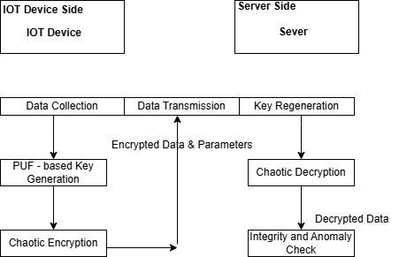
Design- examples
*
Dept of CSE., SOE-Dayananda Sagar University
<number> of 12

Slide 21
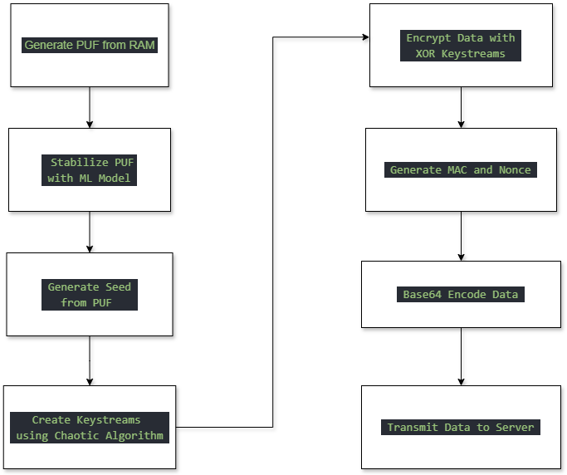
Flowchart
*

Slide 22
Methodology
Data Collection Methods:
  Sensor Data: Simulated temperature, humidity, and RFID tag values.
  PUF Key: Extracted using SRAM power-up variations.
  Encryption Input: Combined sensor data + PUF key + chaotic byte.
Data Preparation:
  Data Formatting: Converted sensor readings into a comma-separated string.
  Encryption: Transformed raw data into a hexadecimal string.
  Encoding: Used Base64 to ensure safe transmission over HTTP.
  Validation: Checked PUF key presence on the server before transmission.
Dept of CSE., SOE-Dayananda Sagar University
<number> of 12

Slide 23
EXPERIMENTATION
Step 1:
  PUF Key Generation: Extracted an 8-bit PUF key from SRAM power-up variations. Used majority voting across multiple SRAM samples to ensure stability.
Step 2:
  Sensor Data Simulation: Generated fixed values: Temperature (10.5°C), Humidity (20.5%), RFID Tag ("Test Rfid"). Prepared data as a comma-separated string for encryption.
Step 3:
  Chaotic Encryption: Applied a logistic map function to generate a chaotic byte. Performed XOR operations with the PUF key and chaotic byte. Converted encrypted data into a hexadecimal string.
Step 4:
  AI/ML-Based Device Health Monitoring: Implemented an ML model to monitor device performance over time. Tracked temperature variations, power fluctuations, and error rates. If degradation is detected, the system triggers PUF key re-registration.
Dept of CSE., SOE-Dayananda Sagar University
<number> of 12

Slide 24
EXPERIMENTATION
Step 5:
  Secure PUF Key Transmission: Before sending encrypted data, the system checks if the PUF key is already registered. Uses hash verification to compare the stored key with the device-generated key. If the key is missing or compromised, a challenge-response mechanism is used to securely re-register the PUF key.
Step 6:
  Data Transmission: Base64-encoded the encrypted data for safe network transmission. Sent verified PUF key and encrypted sensor data to the Flask server. If a new PUF key was generated, it was securely registered on the server. Transmitted the encrypted, Base64-encoded data using HTTP POST.
Step 7:
  Server-Side Processing: Flask server checked key validity before accepting data.ML model on the server analyzed patterns in incoming data to detect anomalies. Encrypted data was stored securely in a database. Verified PUF key integrity for authentication and security.
Dept of CSE., SOE-Dayananda Sagar University
<number> of 12

Slide 25
REFERENCES
[1] Showkat, Sadia, and Shaima Qureshi. "Securing the Internet of Things Using Blockchain." 10th International Conference on Cloud Computing, Data Science & Engineering (Confluence). IEEE, 2020.
[2]Manishankar S, Dechamma TS, and Anoop A. "Securing IoT Data in the Cloud with Blockchain Technology." 2021 Asian Conference on Innovation in Technology (ASIANCON). IEEE, 2021.
[3]Kulkarni, Swati & Vani, R.M & Hunagund, P.V.. (2020). FPGA based Hardware Security for Edge Devices in Internet of Things. 1133-1138. 10.1109/ICCES48766.2020.9138013.
[4]Khan, Naqash & Awang, Azlan & Abdul Karim, Samsul Ariffin. (2022). Security in Internet of Things: A Review. IEEE Access. PP. 1-1. 10.1109/ACCESS.2022.3209355.
[5]Ghaffari, Ali, Nasim Jelodari, Samira Pouralish, Nahide Derakhshanfard, and Bahman Arasteh. "Securing Internet of Things Using Machine and Deep Learning Methods: A Survey." Cluster Computing 27 (2024): 9065-9089.
[6] Ali, Salman & Anwer, Faisal. (2024). Securing IoT Data: A Hybrid Cryptographic Approach. 1561-1569. 10.23919/INDIACom61295.2024.10498695.
*
Dept of CSE., SOE-Dayananda Sagar University
<number> of 12

Slide 26
REFERENCES
[7 ]Humayun, Mamoona & Tariq, Noshina & Alfayad, Majed & Zakwan, Muhammad & Alwakid, Ghadah & Assiri, Mohammed. (2024). Securing the Internet of Things in Artificial Intelligence Era: A Comprehensive Survey. IEEE Access. PP. 1-1. 10.1109/ACCESS.2024.3365634.
[8] Narayan, M. & Trivedi, (Dr.) Munesh & Dubey, Dr Anil. (2023). Securing Data in the Internet of Things (IoT) using Metamorphic Cryptography - A Survey. 401-406. 10.1109/CICTN57981.2023.10141472.
[9] Liu, Benfa. (2023). Application and Research of Chaos Algorithm in Information Security Systems. 375-380. 10.1109/CICN59264.2023.10402319.
[10] Aclkkapl, Mehmet & Ozkaynak, Fatih. (2020). A Method to Determine The Most Suitable Initial Conditions of Chaotic Map in Statistical Randomness Applications. IEEE Access. PP. 1-1. 10.1109/ACCESS.2020.3046470.
[11] Artuğer, Fırat & Özkaynak, Fatih. (2020). A Novel Method for Performance Improvement of Chaos-Based Substitution Boxes. Symmetry. 12. 571. 10.3390/sym12040571.
[12] Arthi, G. & Thanikaiselvan, V. & Amirtharajan, R.. (2022). 4D Hyperchaotic map and DNA encoding combined image encryption for secure communication. Multimedia Tools and Applications. 81. 1-20. 10.1007/s11042-022-12598-5.
(#) of 12

Slide 27
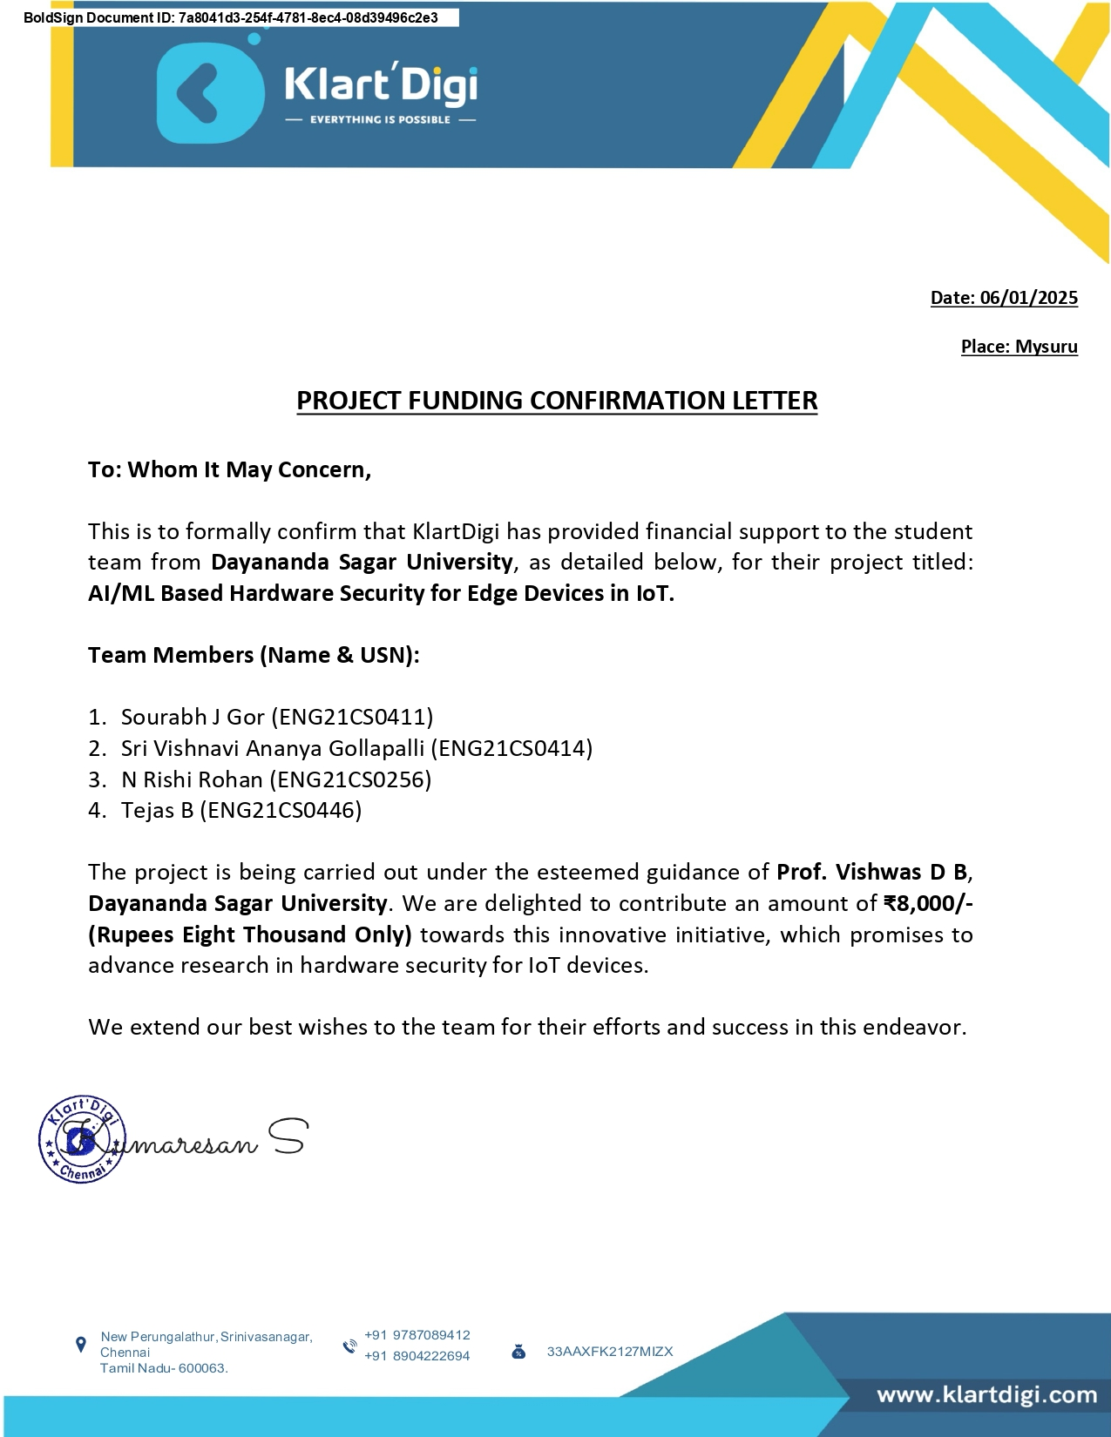
Funding Details:
Dept of CSE., SOE-Dayananda Sagar University
<number> of 12

